Slide 1


Slide 2
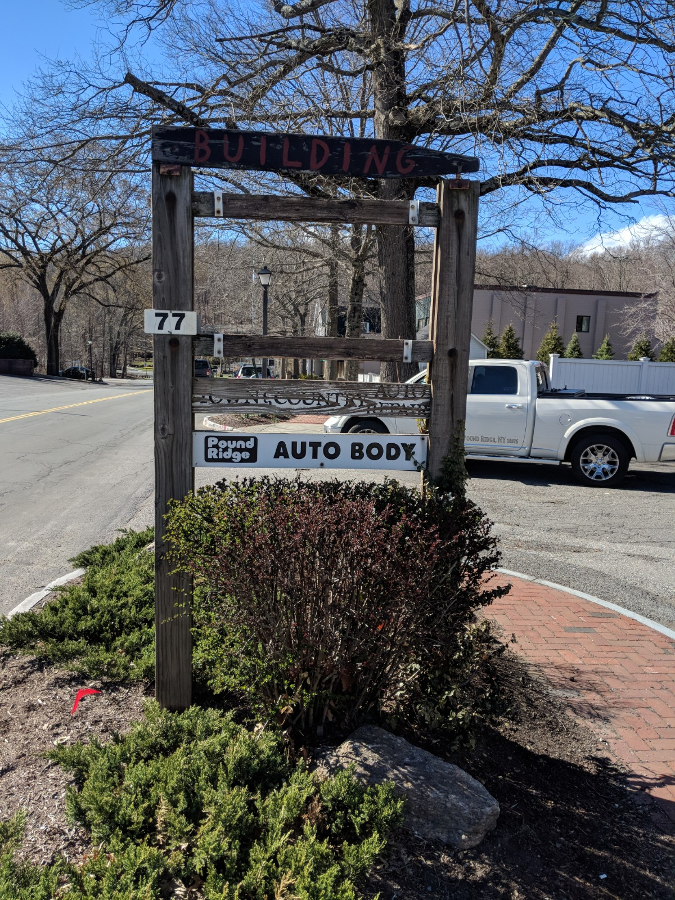
Status
Owned by Town of Pound Ridge since October 2018
Town Board & EDC are currently:
  evaluating next steps
  fielding ideas and offers
  seeking public input

Slide 3
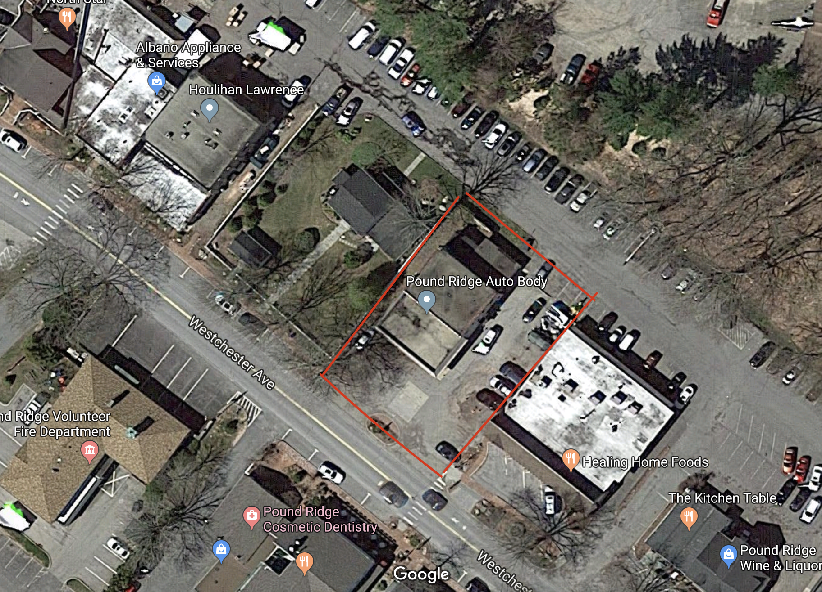
Location
Home of Pound Ridge Auto Body
Between Healing Home Foods and Dynax headquarters
Property includes parking in front of and beside building
Parking also available behind building in town parking lot

Slide 4
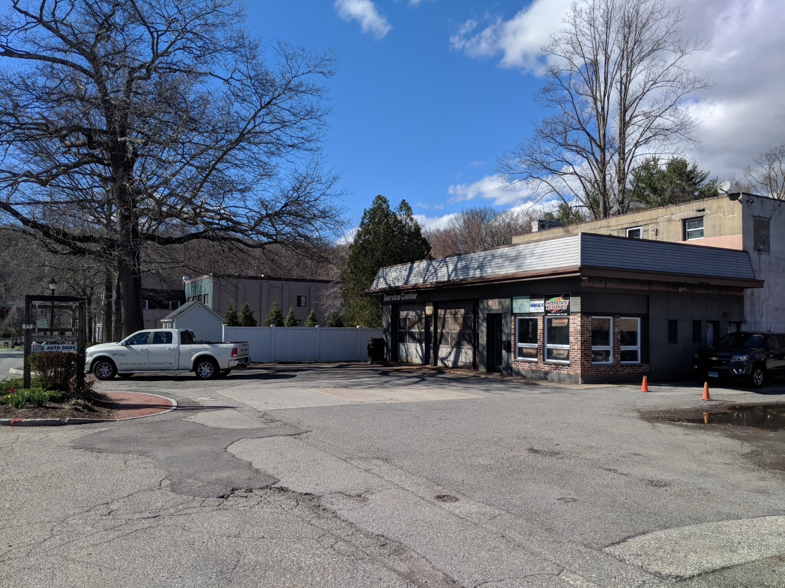
Property Description
Size: 0.34 acres
Square feet: 4,864
Two-story building built in the 1940’s
Former Texaco gas station
Has two vacant apartments upstairs
For more information:
GIS map and environmental studies on Town website
www.townofpoundridge.com

Slide 5
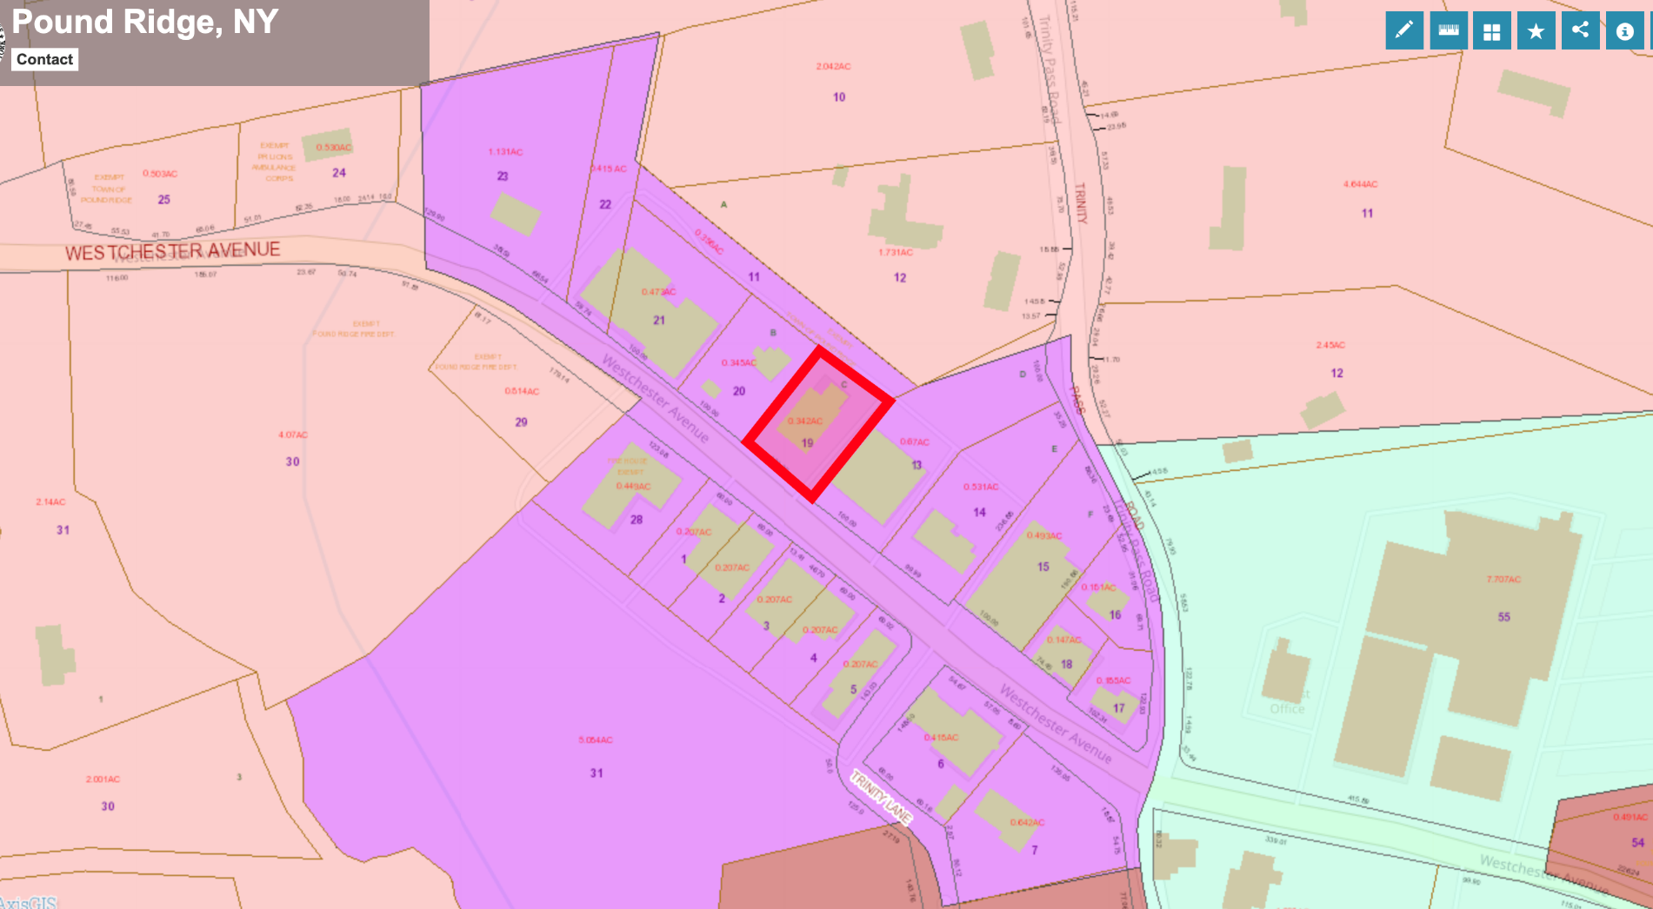
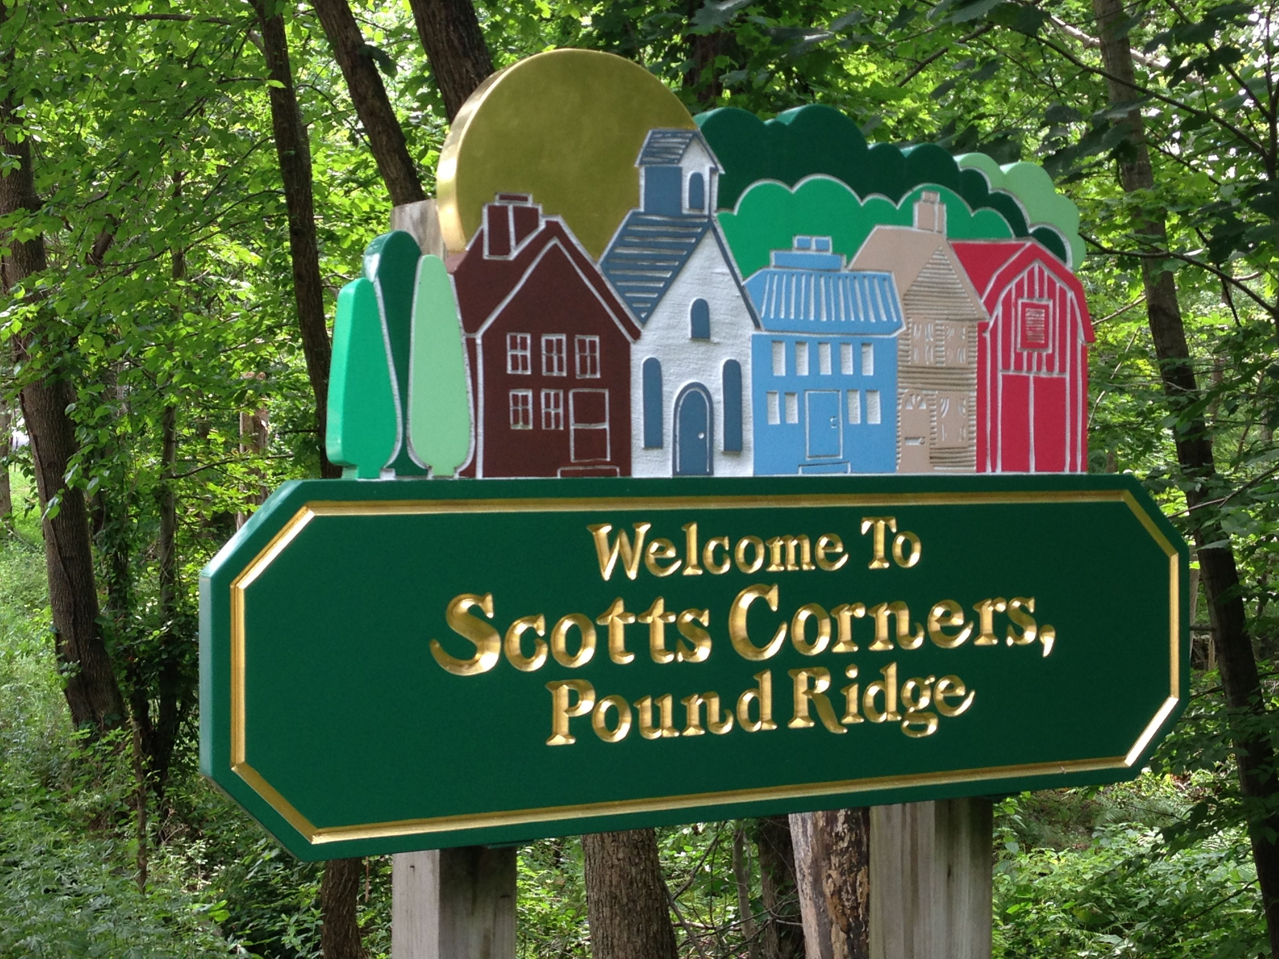
Zoning
Important location in the heart of Scotts Corners
Zoning: Planned Business District A
PBD-A allows wide range of commercial and residential uses
For more information:
Town Code on Town website
www.townofpoundridge.com

Slide 6
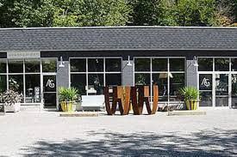

Questions / Ideas?
We want to hear from you!
What would you like to see happen on this site?
What would be a great addition to our downtown?
Concerns or questions?
To contact the EDC e-mail:
edc@townofpoundridge.com

